Slide 1

Employee Attrition Analysis
Data-Driven Insights on Why Talent Leaves
Prepared for Human Resources Management | Project M2

Slide 2





PROJECT OBJECTIVES
Identify Causes
Attrition Patterns
Retention Strategy
Analyze key factors like salary and workload that contribute to employees leaving the firm.
Distinguish behavioral differences between employees who stay versus those who exit.
Provide actionable recommendations to reduce turnover and boost employee morale.

Slide 3
EXECUTIVE SUMMARY
8.32
The Data Tells a Story:
Our analysis reveals a clear correlation: employees leaving the organization are overworked, underpaid, and dissatisfied with their environment compared to their peers who stay.
Avg. Hours (Exited)

Slide 4
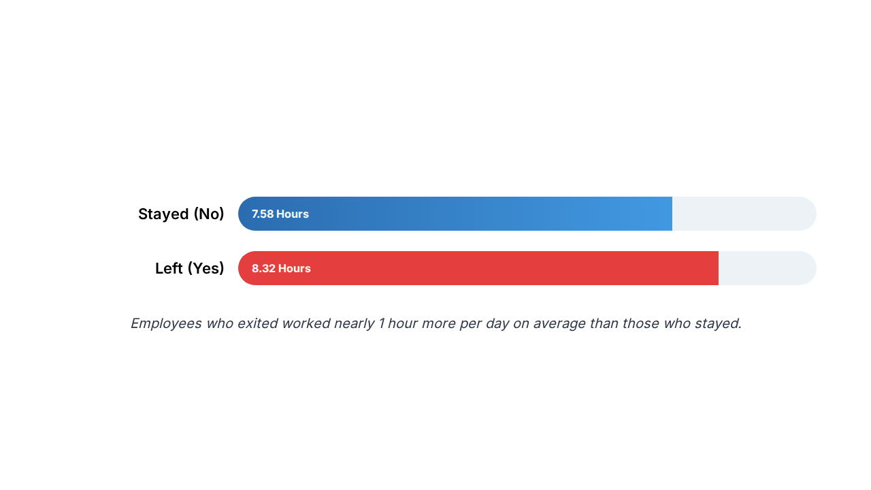
THE BURDEN OF LONG HOURS

Slide 5
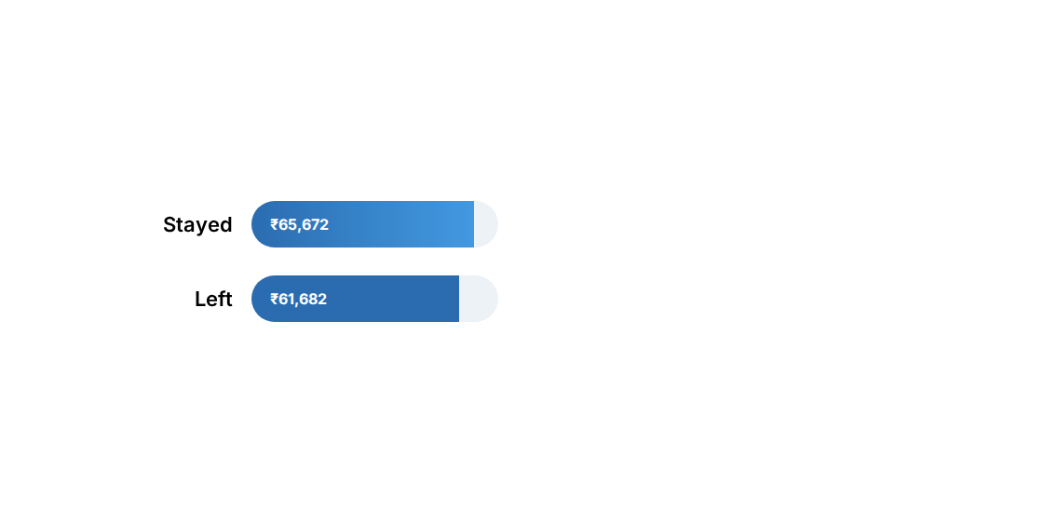


COMPENSATION & INCOME GAP

Slide 6


WORKPLACE ENVIRONMENT
Culture Matters
Environment satisfaction scores (on a scale of 1-4) show a significant dip for employees who left.
Stayed: 2.77 / 4.00
Left: 2.47 / 4.00

Slide 7
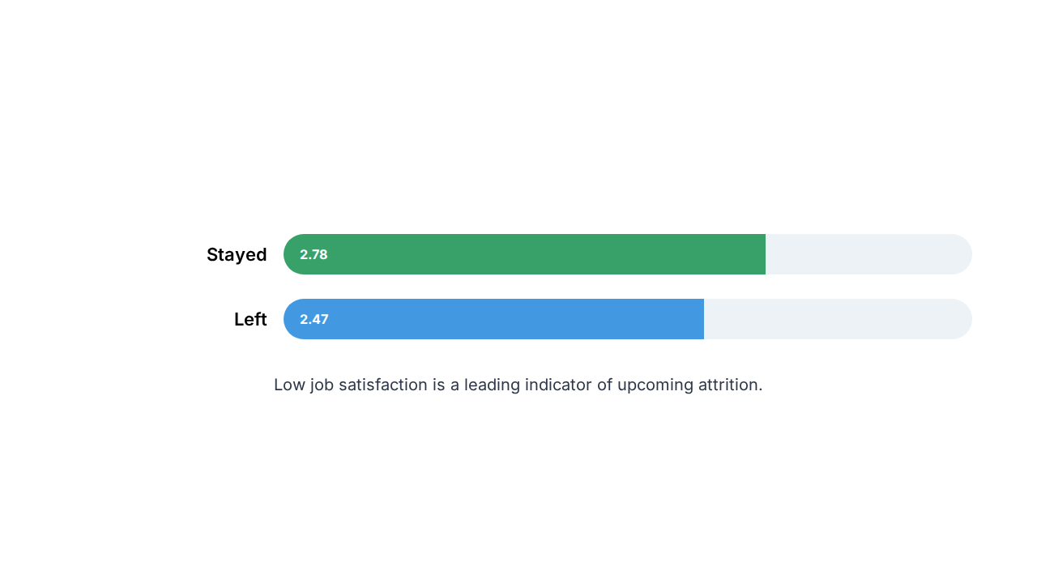
AVERAGE JOB SATISFACTION

Slide 8




THE "EXIT TRIGGER" PATTERN
High Pressure
Low Reward
Consistent overtime (8.3+ hrs) leads to burnout and reduced engagement.
Lower average income (₹61k) makes external opportunities more attractive.

Slide 9
RETENTION STRATEGIES
Work-Life Balance: Cap daily working hours and encourage breaks to prevent burnout.
Competitive Pay: Review salary benchmarks to ensure high-performing talent is paid fairly.
Culture Improvement: Conduct regular feedback sessions to improve office environment satisfaction.
Engagement Programs: Increase job satisfaction through recognition and career growth paths.

Slide 10
Final Conclusions
Attrition is a result of multiple factors. By balancing workloads and aligning compensation with satisfaction, we can significantly reduce talent loss.

Slide 11
Questions?
Thank you for your time and attention.

Slide 12

Employee Attrition Project
Analyzing People, Predicting Growth.
End of Presentation

Slide 13



IMAGE SOURCES
https://static.vecteezy.com/system/resources/previews/066/038/107/non_2x/salary-or-wages-employee-income-or-career-development-job-performance-pay-equality-or-motivation-to-career-growth-concept-business-people-on-growing-money-coins-as-salary-or-wages-payment-vector.jpg
Source: www.vecteezy.com
https://cdn.prod.website-files.com/6486cea2e365df2928fc33bd/67c1515bb8ef64911e46c942_Ideas%20to%20improve%20workplace%20Singapore.webp
Source: www.praisepal.com
https://images.presentationgo.com/2025/05/business-team-collaboration-office.jpg
Source: www.presentationgo.com

